Slide 1
Spring Reactive
Playbook

Slide 2
Table of content
Reactive Programming
Business Use Case
Solution Approach
Prerequisite Software & Tools
Implementation Details
Challenges Faced
Troubleshooting & Resolution

Slide 3
Reactive Programming
With advancements in the technical landscape, applications need to be reactive(flexible, loosely coupled, and scalable), and users are expecting results within the next second after submitting the request. Hence there is a need to build a system that is highly reactive and executes the requests in parallel.
Features of Reactive Programming:
Non-Blocking: Reactive programming is a declarative programming paradigm that is based on the idea of asynchronous event processing and data streams.
Asynchronous: Asynchronous processing means that the processing of an event does not block the processing of other events.
Back Pressure: The ability of the consumer to request items at different rates or only when it is ready to process them.
Event Driven: Web applications adopt non-blocking servers based on the event loop model.

Slide 4
Reactive Streams
Spring Web Flux supports the Reactive Stream API, which is a standardized tool for processing asynchronous streams with non-blocking backpressure.
Reactive streams have a publisher (producer) — subscriber (consumer) model. The publisher emits an event, and a subscriber will read it.
In the Reactive Streams API, there are four main interfaces:
  Publisher — Emits events to subscribers based on the demands received from its subscribers. A publisher can serve multiple subscribers and it has only one method: subscribe
  Subscriber — Receives events emitted by the Publisher. The subscribe has four methods to deal with the events received: onSubscribe, onNext, onError , and onComplete
  Subscription — This represents the relationship between the subscriber and the publisher. It has methods that allow requesting for data request(long n) and to cancel the demand of events cancel()
  Processor — Publisher and subscriber at the same time; rarely used.

Slide 5
Project Reactor
Spring Web Flux internally uses Project Reactor and its publisher implementations, Flux and Mono.
Mono — A publisher that can emit 0 or 1 element.
Flux — A publisher that can emit 0..N elements. Mono and Flux offer simple ways of creating streams of data:
Reactor offers several operators for working with Flux and Mono objects. Most commonly used are:
Map — Used to transform the publisher elements to other elements
FlatMap — Similar to map, but the transformation is asynchronous
FlatMapMany — Mono operator used to transform a Mono into a Flux
DelayElements — Delays the publishing of each element by a given duration
Concat — Used to combine publishers’ elements by keeping the sequence of the publishers
Merge — Used to combine publishers without keeping the publishers’ sequence, instead it interleaves the values
Zip — Used to combine two or more publishers by waiting on all the sources to emit one element and combining these elements into an output value.
doOnError- we can invoke whatever action that is needed when there is an error.
onErrorResume: Gives a fallback stream when some exception occurs happens in the upstream.

Slide 6
Business Use Case
The major challenge for any e-commerce application is to scale and support concurrent requests coming from the users, hence creating the orders.
To cater to this challenge, we have implemented microservices using Spring web flux which supports reactive programming for checkout functionality.
Reactive microservices are highly scalable and resilient.
Business Features
  Add products to the basket
  Retrieve the products from the basket
  Update the details of the basket
  Create the order

Slide 7
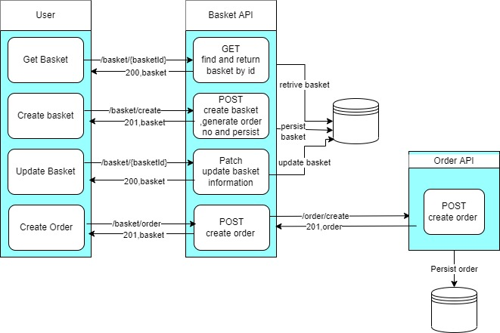
Solution Approach
To cater to the business use case, we have implemented the below-mentioned microservices:
Below is the solution flow diagram:

Slide 8
Prerequisite Software & Tools
Java
Maven
Docker Desktop
Postgres Database :Eclipse(Or Any other IDE )
Installation Links:
JDK 17 Installation on Windows 10 [step-by-step] – Javacodepoint
How to install Maven – javatpoint
Install Docker Desktop on Windows | Docker Documentation
PostgreSQL: Documentation: 15: 1.1. Installation
Eclipse Installer 2023-03 R | Eclipse Packages

Slide 9
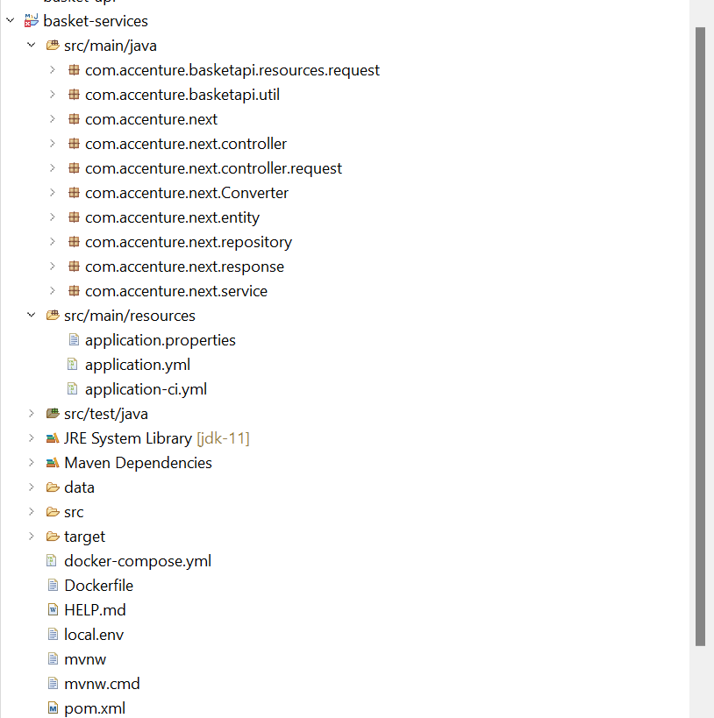
Project Structure

Slide 10
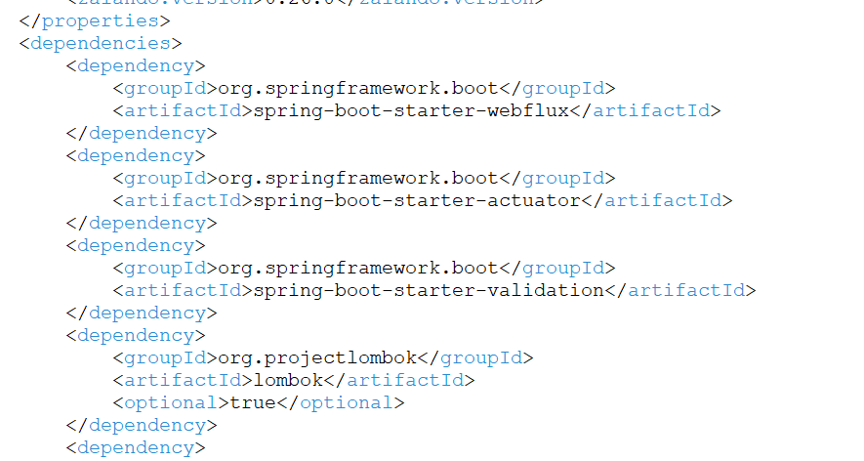
Implementation Details
Configuration Files:
Pom.xml
Pom file includes all the project-specific dependencies like Java 17, Spring Web flux, Project reactor, Zalando, PostgreSQL, r2dbc, Spring Boot validation, Junit, and Lombok.
This file will download all the Maven dependencies.
Spring Web flux, Project reactor, and R2DBC dependency need to be added which supports reactive programming.

Slide 11
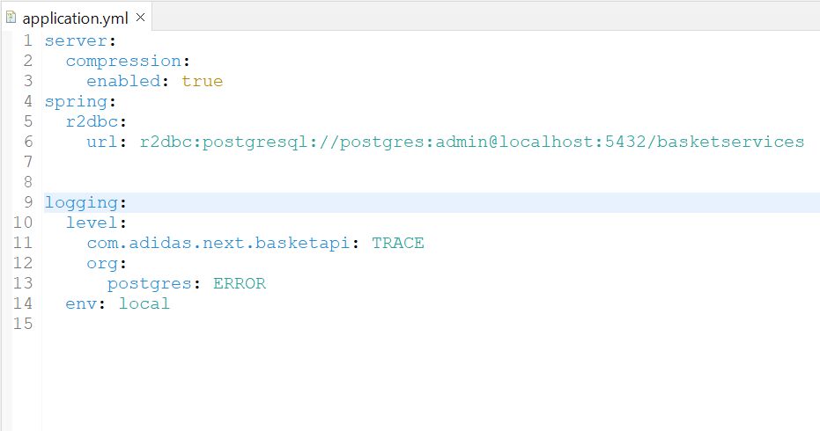
Application.yaml
It is a file wherein we define the configuration data required for the project. AT application startup all the configurations are read from this file.
We can define configurations like database servers, logging , change in port number etc.
Define PostgreSQL database and logging configuration.

Slide 12
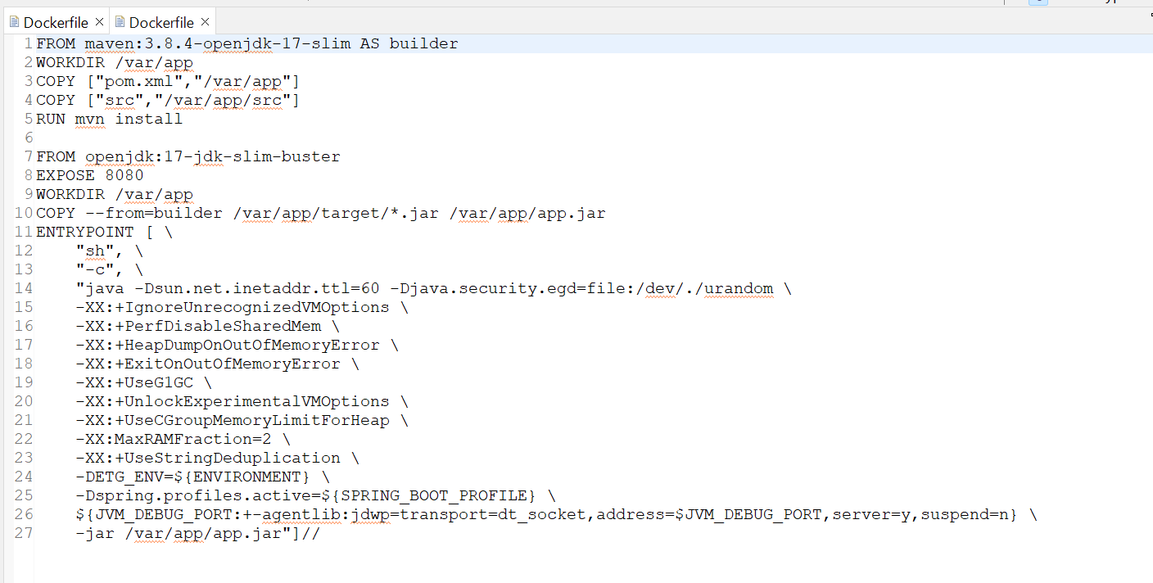
Dockerfile.yaml
A Docker file is a text document that contains commands that are used to assemble an image.
Docker builds images automatically by reading the instructions from the Docker file. For example, jdk, maven etc.

Slide 13
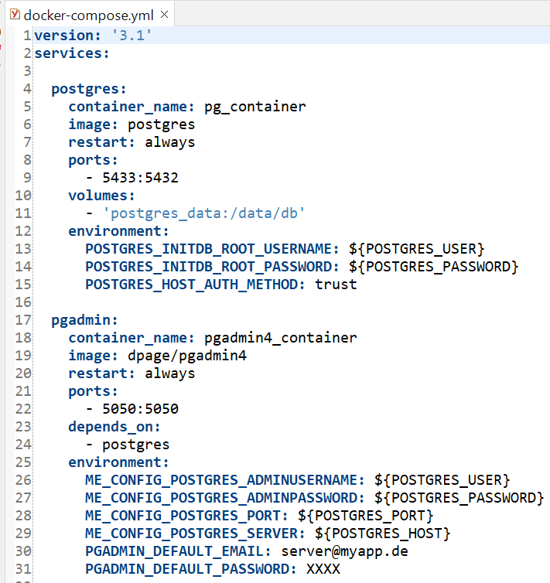
Docker-compose.yaml
Define the services that make up your application in docker-compose.yml so they can be run together in an isolated environment.
Docker-compose.yaml file is used to run images.

Slide 14
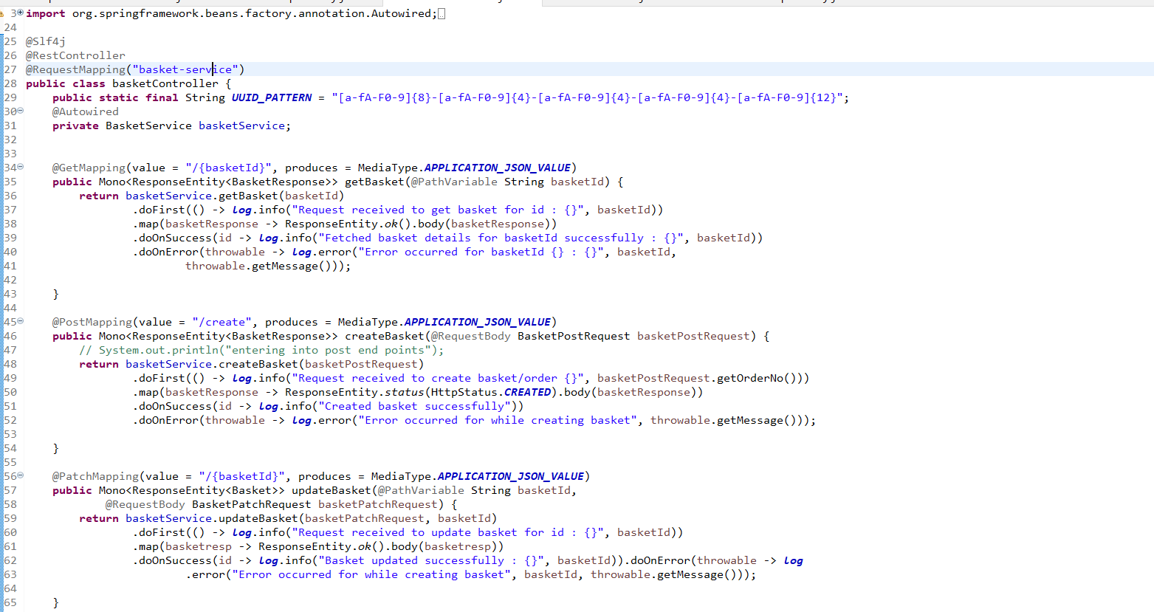
Controller Layer
Controller layer is responsible for processing incoming REST API and returning the view to be rendered as a response.
Define request mapping along with Get/Post/Put endpoints and calling service layer.
@RestController annotation is used to mark the class as a controller below.
All the REST APIs will be asynchronous and will return a Publisher (Mono or Flux).

Slide 15
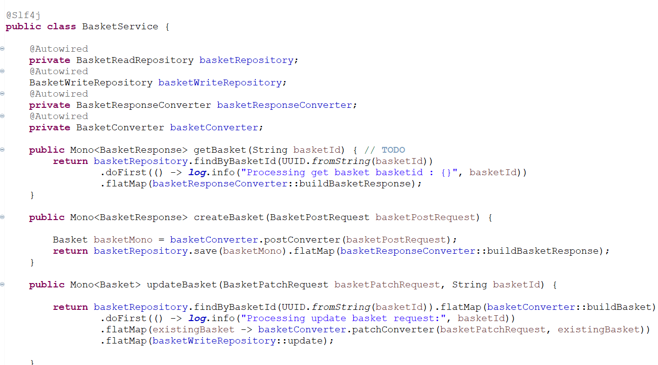
Service Layer
Layer that facilitates the communication between the controller and the persistence layer.
Holds the business logic.
@Service annotation used to annotate this as a service class.

Slide 16
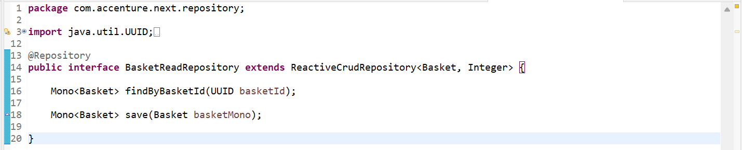
Repository Layer
Fetch a record from the database.
We have defined the function to find the customers and the return type will be Flux since there can be more than one customer belonging to the same category.
@Repository annotation is used to mark this class as a repository.

Slide 17
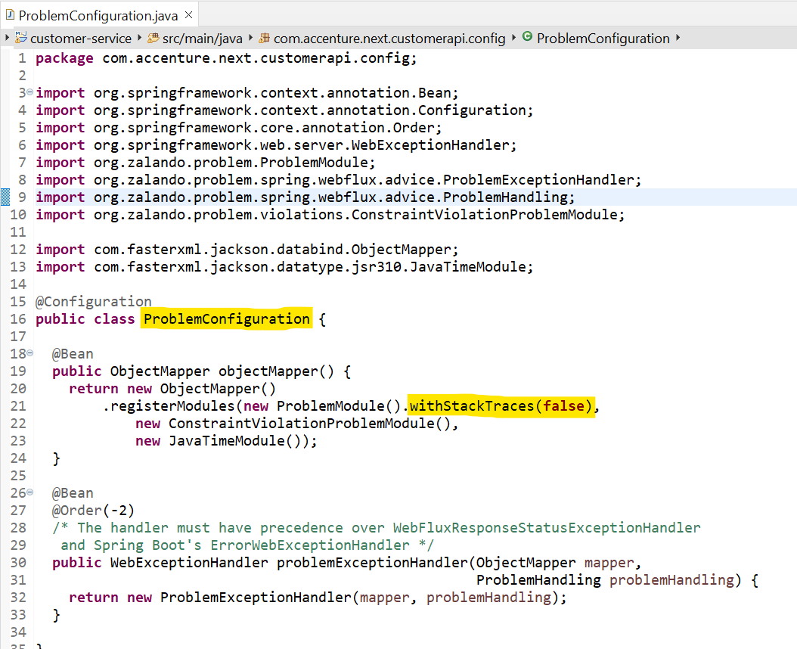
Exception Handling
Produce application/problem+json responses using the Problem Spring Web library. This library helps us to avoid repetitive tasks related to error handling.
By integrating Problem Spring Web into our Spring Boot application, we can simplify the way we handle exceptions within our project and generate responses accordingly.

Slide 18
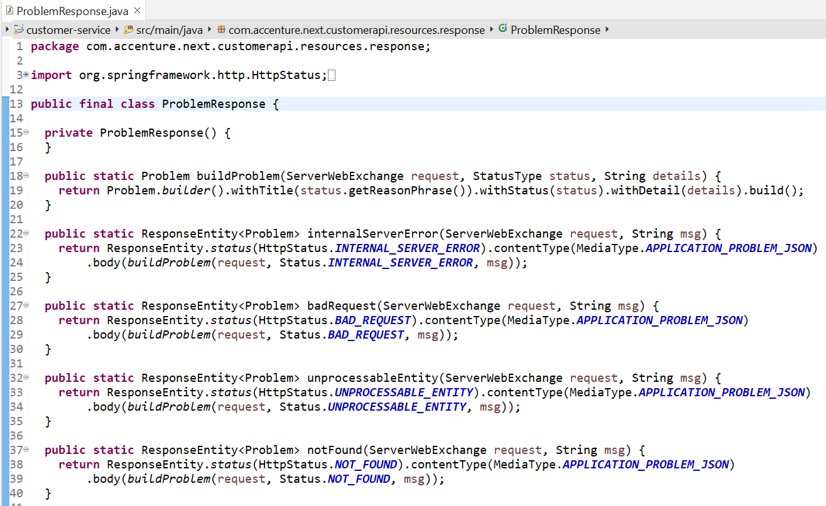
Problem Response
Preparing error responses with custom fields like Error title, status, and code.

Slide 19
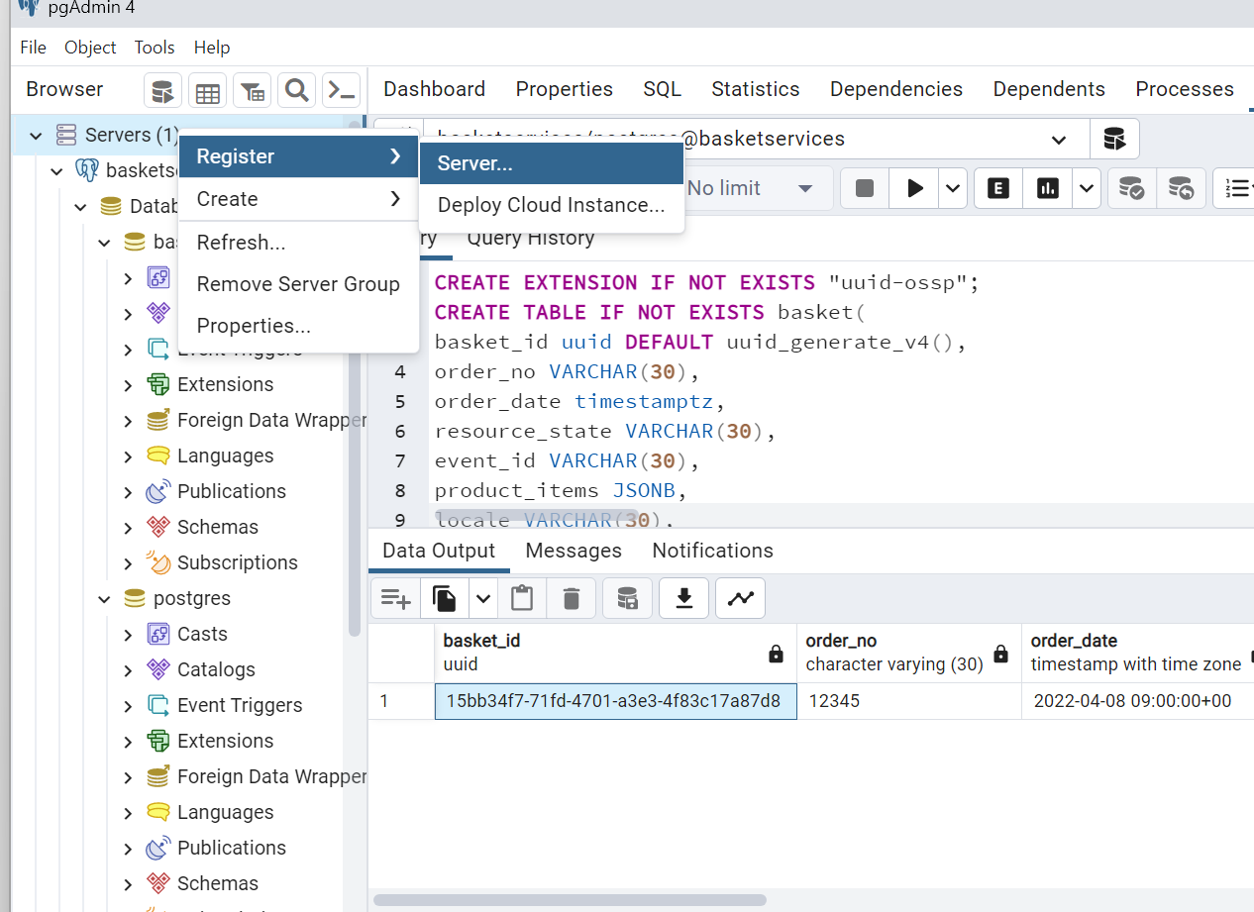
DataBase Setup
Create a Database in PgAdmin4
Right Click on server->Register-> click on server
.

Slide 20
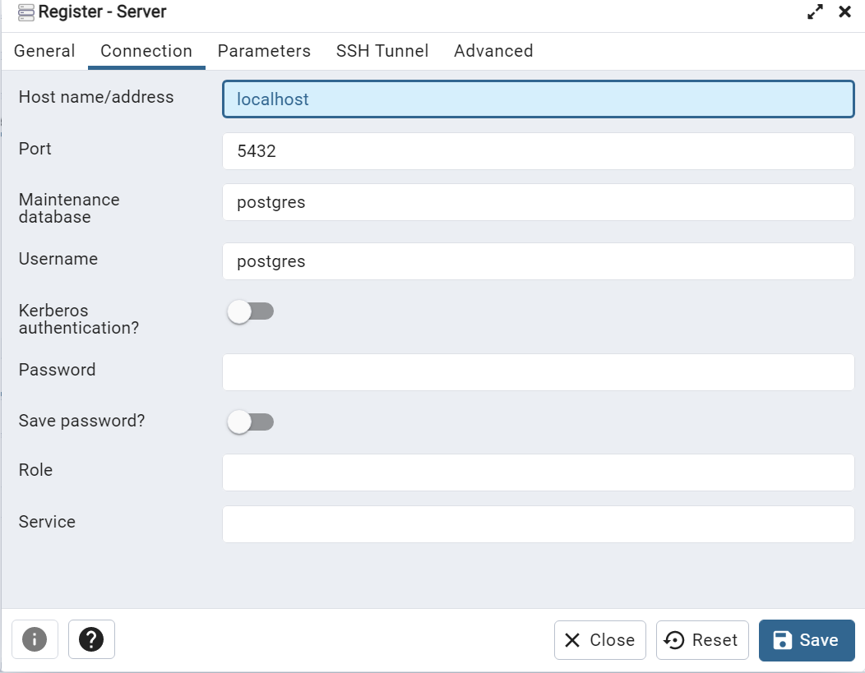
DataBase Setup
Click on general tab-> write name -> go to connection tab -> give localhost name and port number
.

Slide 21
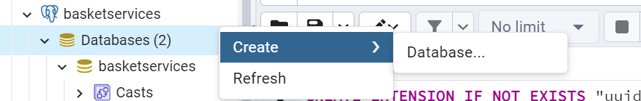
DataBase Setup
Now create Database-> Right click on database-> click on create-> Database-> write database name.
.

Slide 22
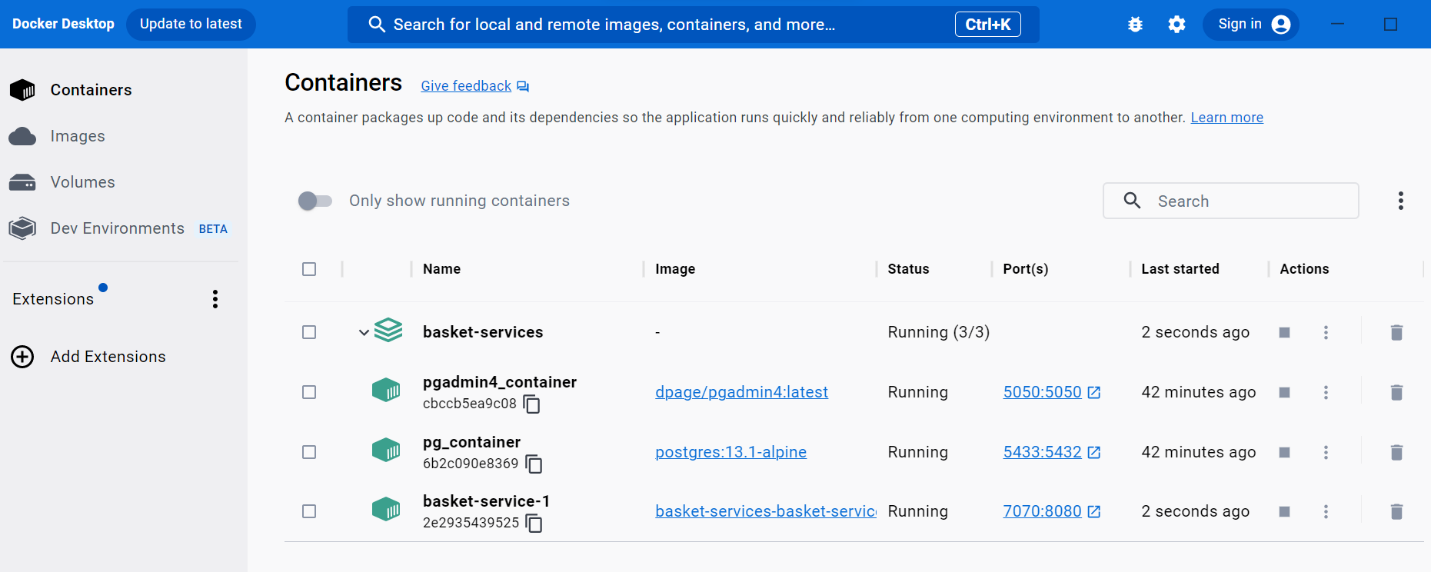
Reactive Application Up & Running
We can run applications either using spring boot main class or docker desktop. To run docker-compose locally, run the following commands
cp local.env .env
docker-compose up -d --build
To stop running containers, run the following commands
docker-compose down

Slide 23
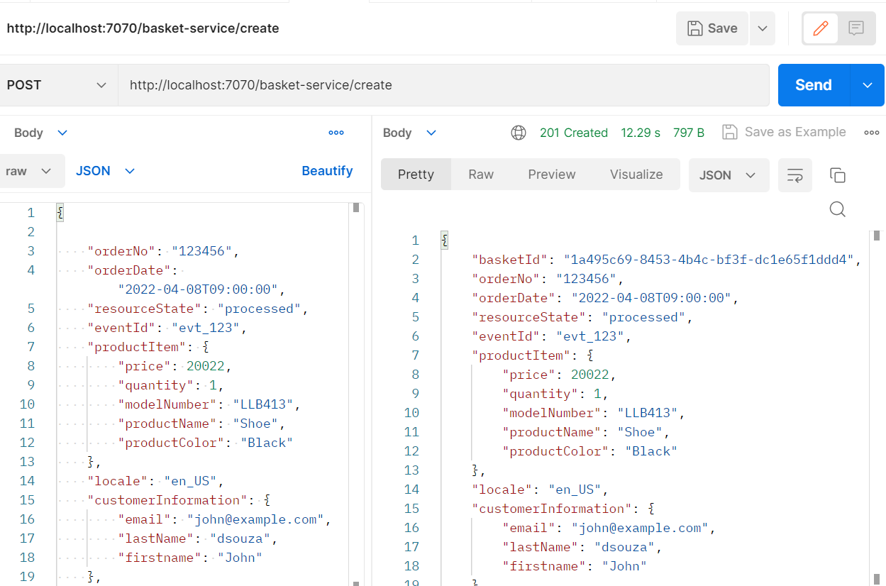
Post Endpoint Snippet

Slide 24
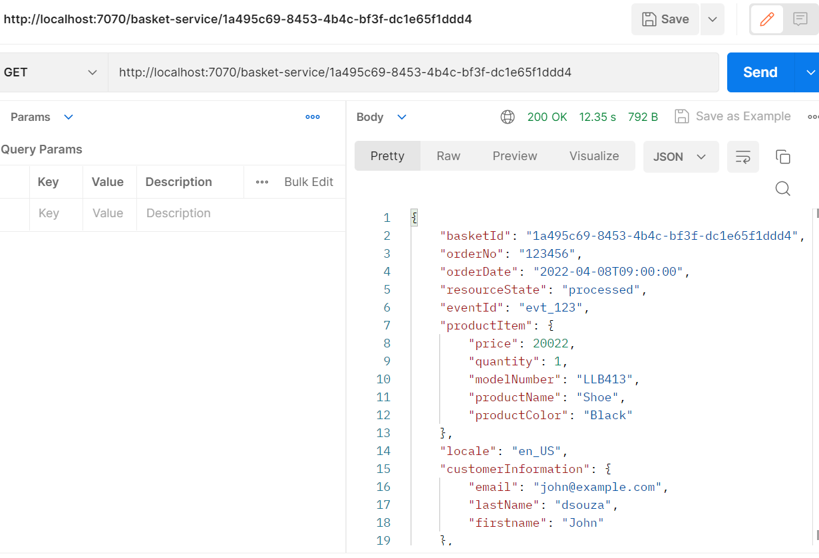
Get Endpoint Snippet

